Slide 1

Logistics services supporting the Circular Economy
PAOLO GUIDI
Sales & Marketing Director
KUEHNE + NAGEL ITALIA

Slide 2

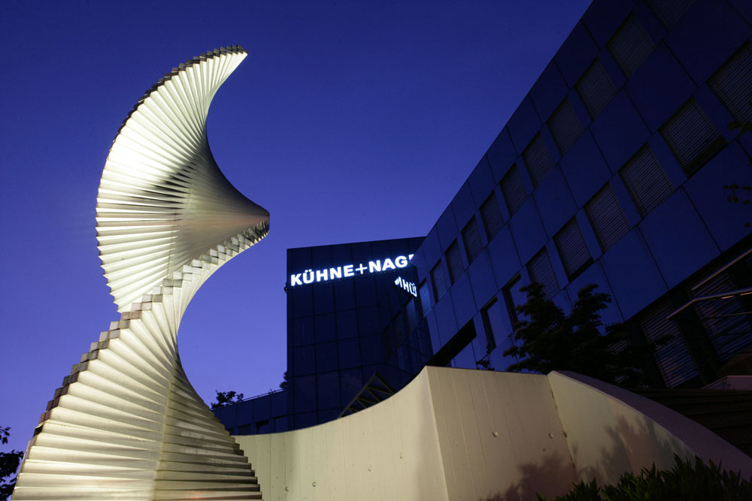
More than 125 Years of Logistics Excellence
Kuehne + Nagel has evolved from a
traditional international freight
forwarder to a leading global
provider of innovative and
fully integrated supply
chain solutions.
1890
1950 - 2000
2010
Today
Founded in Bremen, Germany by August Kuehne & Friedrich Nagel
International Expansion, Acquisitions and Organic Growth
The world’s largest logistics provider in terms of combined air- and seafreight revenue
More than
100 countries,
1,300 locations, more than 79,000 employees
Source: Transport Intelligence

Slide 3

The Global Logistics Network
Worldwide network –
1,300 locations in over 100 countries
Integrated service portfolio – approximately 79,000 employees
Net Turnover of CHF 18,594 million in 2017
Kuehne + Nagel has evolved from a
traditional international freight
forwarder to a leading global
provider of innovative and
fully integrated supply
chain solutions.
SEAFREIGHT
AIRFREIGHT
OVERLAND
CONTRACT LOGISTICS
Over 4.4 million TEUs handled
1.6 million
tons handled
18.4 million
shipments
Over 10.6 million m2
warehousing

Slide 4
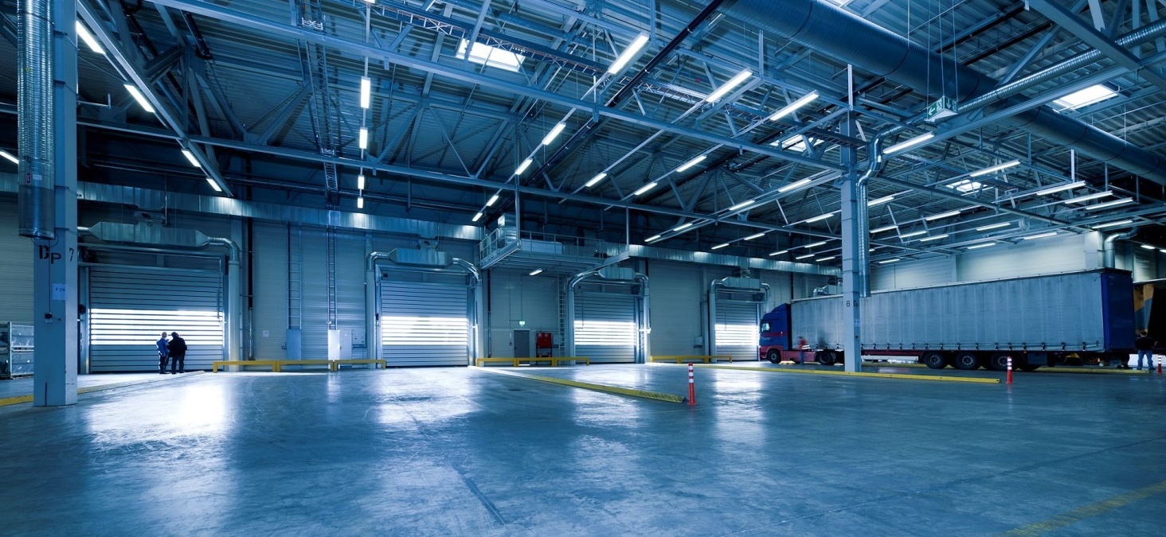
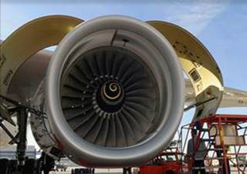

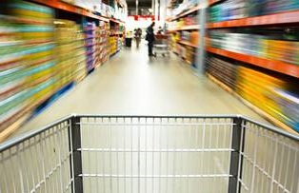


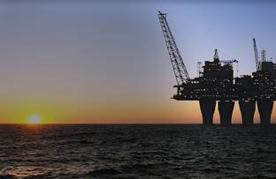

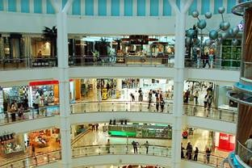
Dedicated Solutions for the World’s Major Industries
Aerospace
Automotive
Consumer
High-Tech
Industrial
Oil & Gas
Pharma & Healthcare
Retail
4
Kuehne + Nagel November 2018 Confidential

Slide 5
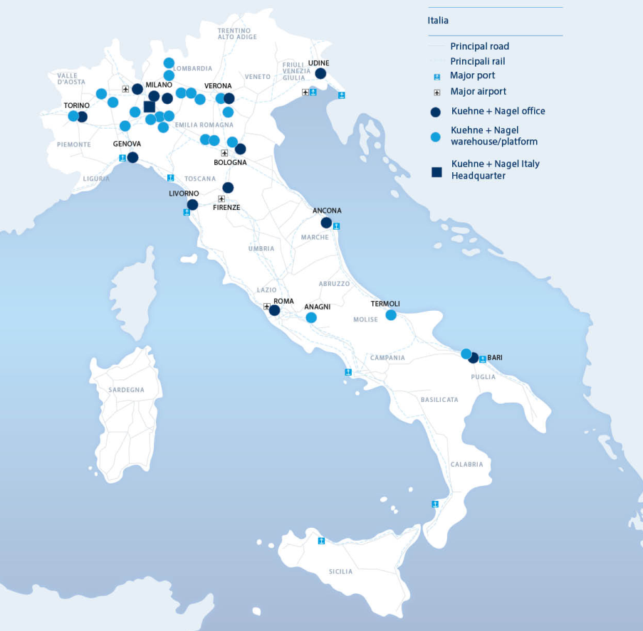
Key Fact & Figures
More info at www.kuehne-nagel.it
40 locations
Established in Italy in 1964
Head Office in Milan (NEW!)
Employees ~ 3,000
Warehousing Space ~ 600,000 sqm

Slide 6
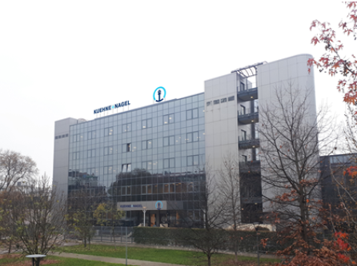
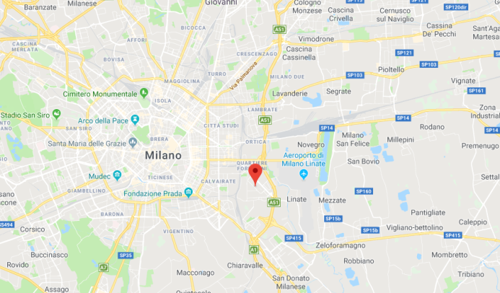
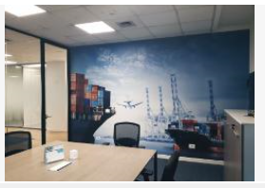
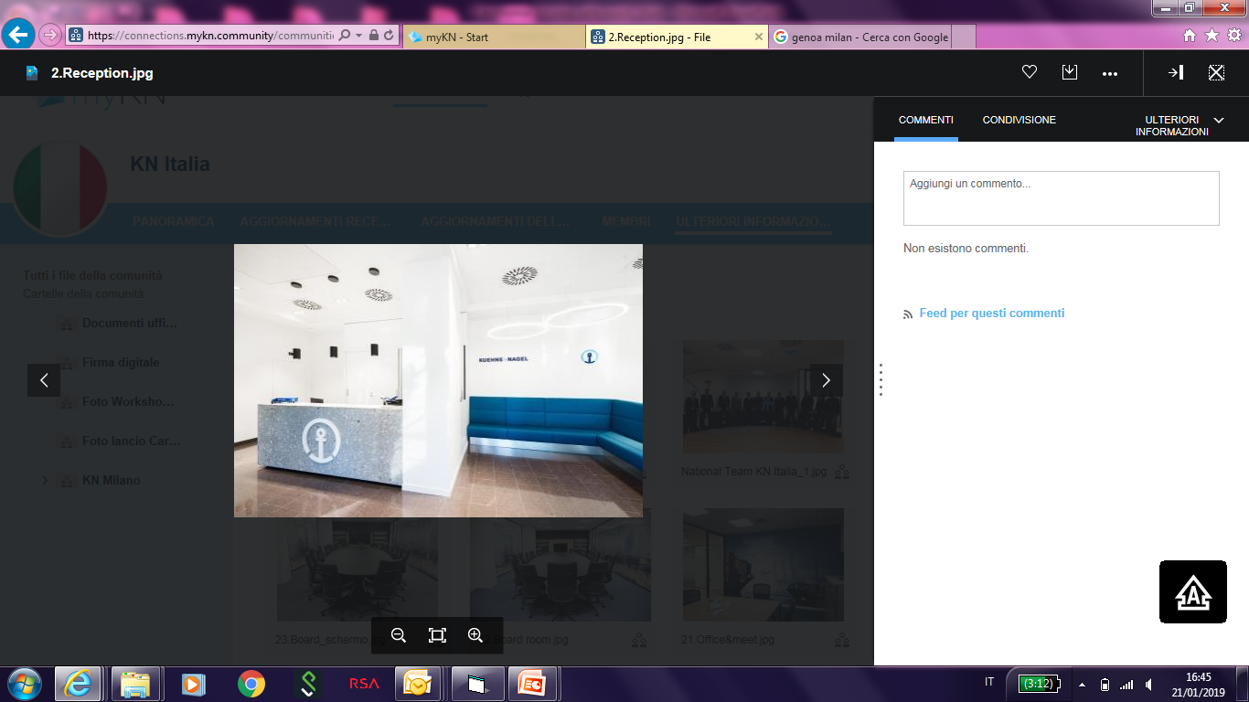
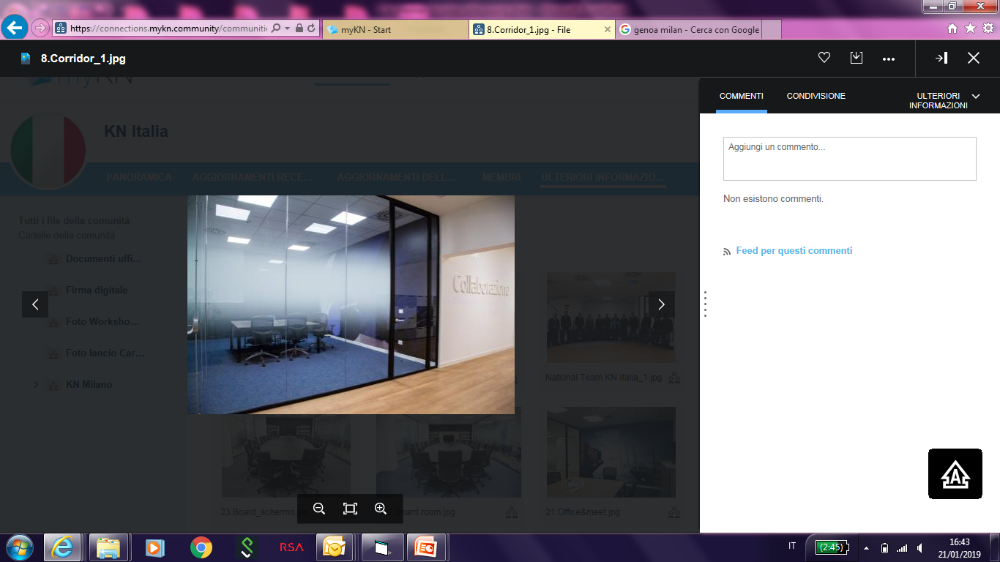
New Italian Headquarters
Milan (Nov 2018)
November 2018: Kuehne + Nagel Italy inaugurates the new italian headquarters
Now Airfreight, Overland and Contract Logistics are located together in the new office in Milan, at via Quintiliano 49

Slide 7
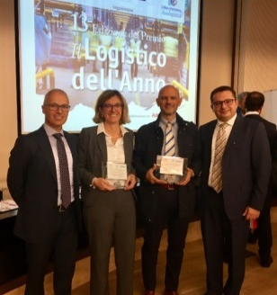
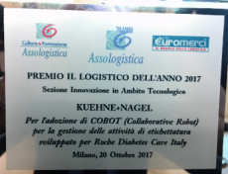
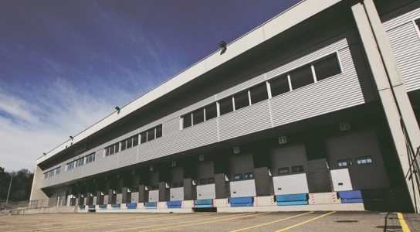

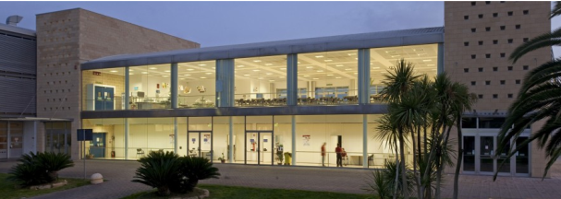


Italy Milestones
Cases of success (last 14 months)
October 2017: Kuehne + Nagel Italy won the Logistics Award of the Year assigned by Assologistica in joint with Roche Diabets Care focus on «Innovation Section» due to the introduction of CO.BOT to manage the labelling processes in automatic way
January 2018: start-up of the new Gloabl spare parts Warehouse implemented for Leonardo Aircraft Division close to Malpensa Airport
Warehouse of 10.000 sqm
QSHE +
February 2018 : New Kuehne + Nagel Warehouse in Bari implemented for Magna & Getrag; Kuehne + Nagel is operating «in house» providing line feeding & warehouse management
Warehouse of 10.000 sqm

Slide 8
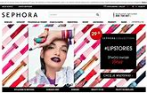
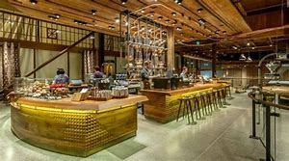

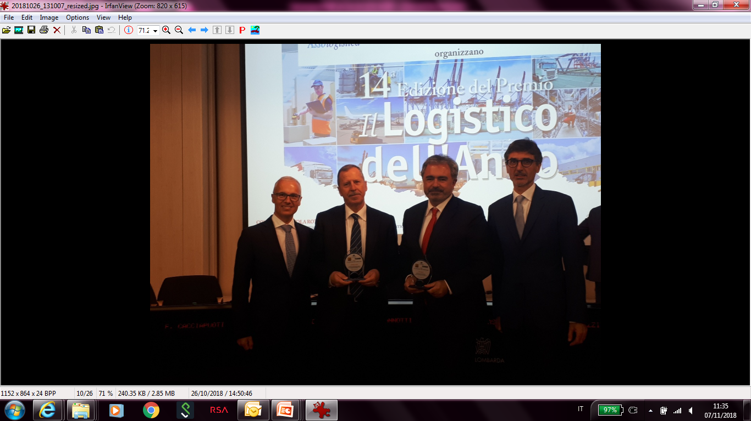
Italy Milestones
Cases of success (last 14 months)
April 2018: Kuehne + Nagel Italy integrates the services provided to Sephora with the management of the e-commerce warehouse (Sephora e-store)
June 2018: Kuehne + Nagel Italy start to provide the NEW Food service to Percassi and Siren Coffee referring to the food market sector.
Kuehne + Nagel provides the warehouse activities and the milk-run distribution
October 2018: Kuehne + Nagel Italy won the Logistics Award of the Year assigned by Assologistica in joint with Leonardo focus on «Innovative Approach in the Business Internationalization Process »

Slide 9

How we can support the
Circular Economy?

Slide 10
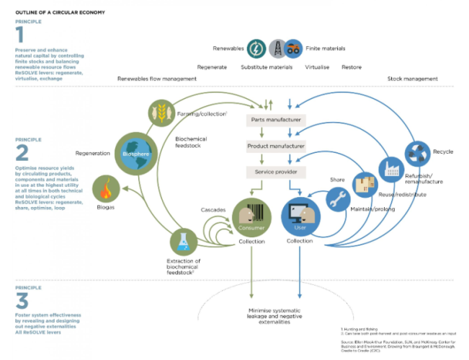
Circular economy is relevant: suitable services
Key steps so far and goals for Kuehne + Nagel
Understand full scope of logistics activities related to Circular Economy
Identify suitable service Kuehne + Nagel can deliver to the Circular Economy (existing and new)
Develop consistent go-to-market approach to address the Circular Economy
Embed solution offering in activity plans of account manager where applicable
Origin
Concept developed by a NGO (foundation)
Several companies across multiple verticals have signed-up to it
Also outside of foundation scope, many companies start focusing on circular economy

Slide 11
Product Life Cycle Services
Logistics solutions to support the Circular Economy

Slide 12

Our sustainability approach
Environmental compliance management
Climate change management
Energy management
Air quality management
Waste management
Water management
Biodiversity management

Slide 13
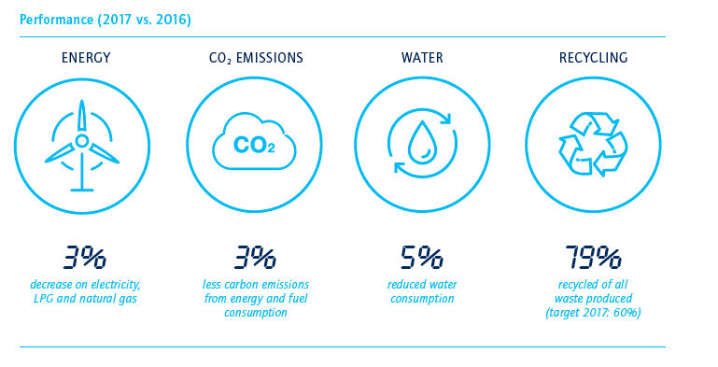
Our sustainability approach

Slide 14
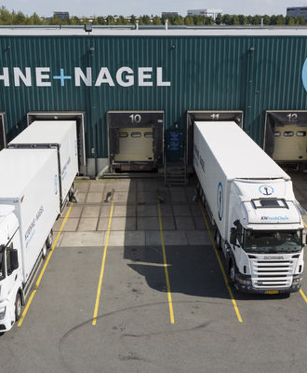
Go-to-market approach
Forward logistics solutions: integrate planning and execution of deliveries
Kuehne + Nagel services
Integrated planning and execution of outbound flows across all transport modes
Leading competency in seamless transport execution
Global supply chain management across all transport modes and across multiple service providers
End-to-end supply chain visibility and reporting for deliveries and return flows
Customer value
Cost optimization
Improved supply chain flexibility and performance
Improved end-to-end supply chain visibility
Example

Slide 15
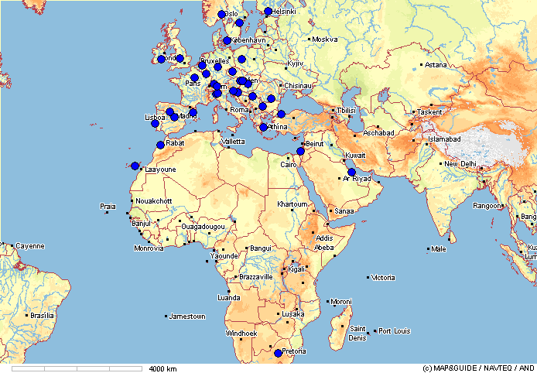
Go-to-market approach
Return Networks for its customers
Kuehne + Nagel services
Management of return networks and RMA processes
Network design concept and optimization
End-to-end supply chain visibility on return flows
Efficient returns processes under single integrated IT system
Consolidation and Visibility at country level
Consistent SLAs & Reporting
Customer value
High service performance in returns, consistent across multiple countries
Full Returns visibility on box/part/product level
Compliance with local regulations
Example

Slide 16

Go-to-market approach
Carbon measurement and improvement
Kuehne + Nagel services
Calculate CO2 emission from all transportation partners based on operational data under one single reference system
Calculate CO2 emission for KN operated warehouses
Identify measures for reduction of CO2 footprint
Monitor and support implementation of agreed measures for CO2 reduction along the entire supply chain
Customer value
Complete visibility of the CO2 footprint
Access to state-of-the-art measures for CO2 reduction
Consistent tracking of positive impacts from measures to reduce CO2 footprint

Slide 17

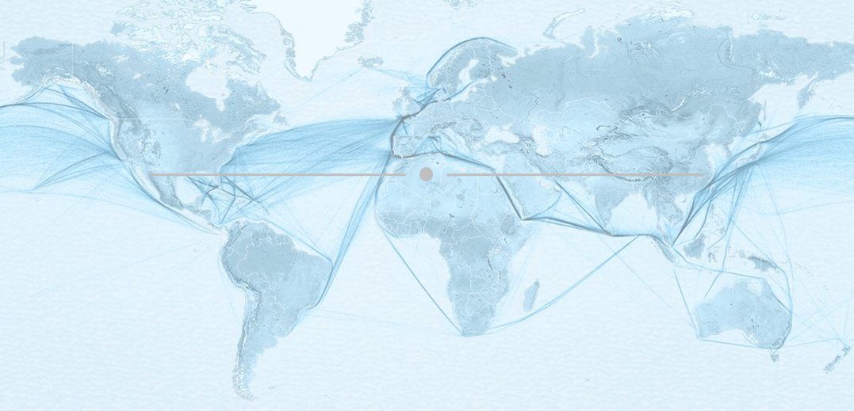
One single platform providing ultimate flexibility and visibility for seafreight supply chain planning
Full transparency of quality and sustainability for each service based on Big Data technology
Smart and fact based decision making
Extensive coverage
Powered by Kuehne + Nagel
Customer Benefits
Over 63,000 port pairs
More than 1,200 port of calls
Over 750 direct weekly services
Smart indicators on transit times, schedule reliability and CO2 emission
Best in class seafreight expertise
Advanced pathfinding algorithm
Over 2,000,000 million data sets per day
More than 500,000 daily operational status messages
Unlock new possibilities for data-driven seafreight supply chain planning
Improve supply chain velocity and agility
Improve inventory level management
Reduce carbon footprint

Slide 18
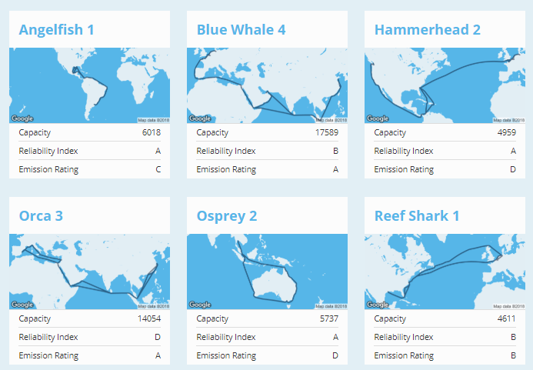
CO2 Emission across carriers
Rated in categories from A - F
  CO2 Emission Rating, in accordance with Clean Cargo Working Group (CCWG) calculation schemes, based on Kuehne + Nagel data
  Derived from vessel level AIS route historical data, technical engine and fuel consumption specifications, as well as capacity data
  Categories are expressed as grams of CO2 emissions per TEU transported 1 kilometer, with A<50, B<60, C<70, D<80, E<90, F>=90
Emission ratings for indirect connections are based on a pro rata calculation of individual service legs’ emission values taking the distance of individual leg into account.

Slide 19
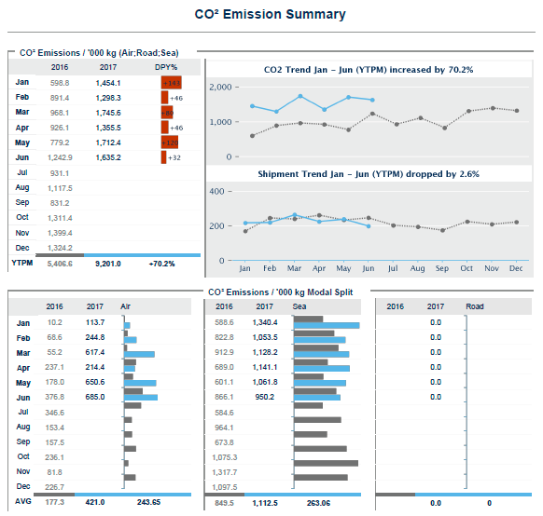
CO2 Emission
Global Transport Carbon Calculator:
CO2 REPORTING
(Global Transport Carbon Calculator)
Attivo per tutte le modalità di trasporto (Air, Sea & Road), fornisce report costanti ed aggiornati sull’emissione di CO2 di tutti i nostri vettori a livello globale.
.

Slide 20

Thank you

